Slide 1
Connections Between Continuous and Combinatorial Total Problems
Manolis Zampetakis
UC Berkeley
(moving to Yale CS in September 2023)
NTUA
January 2023

Slide 2
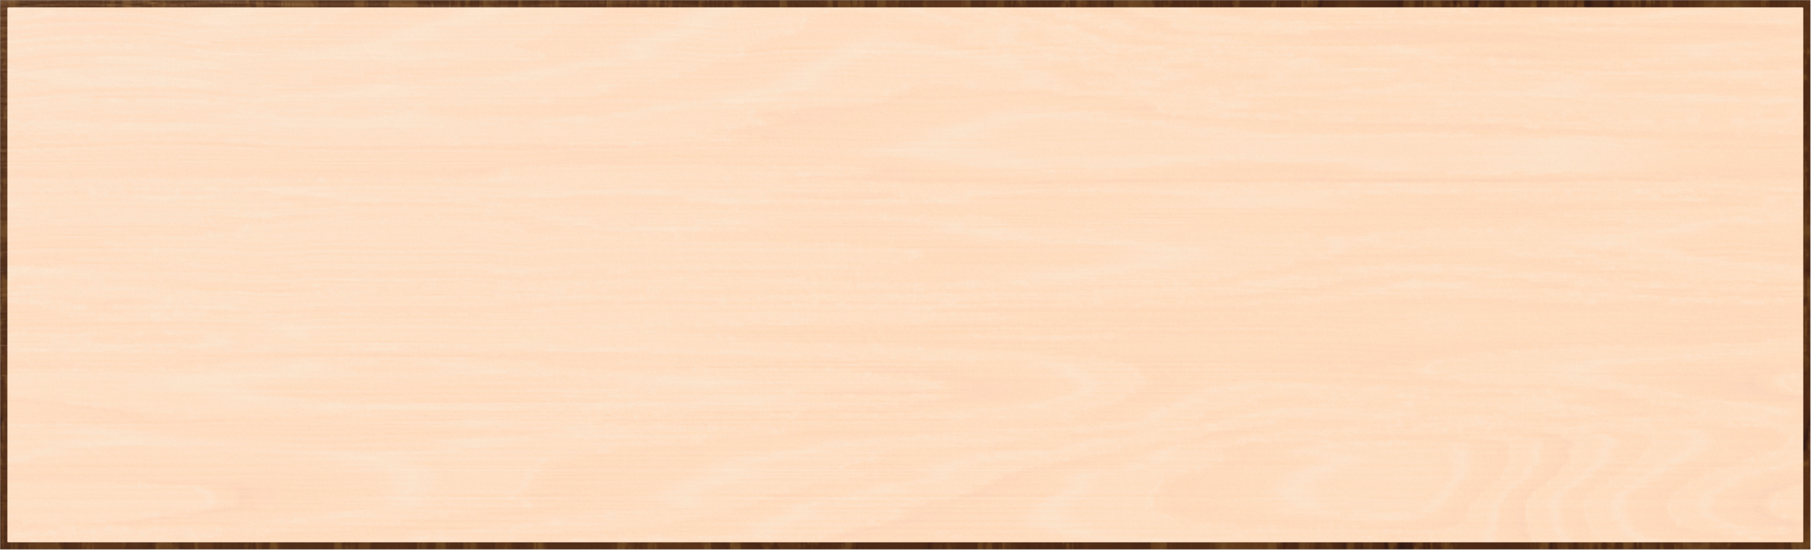
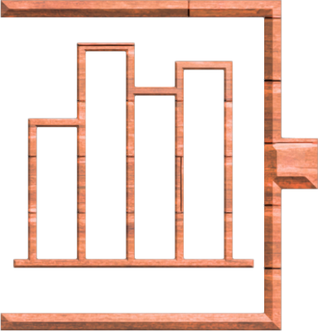

Machine Learning
Statistics
Optimization

Slide 3

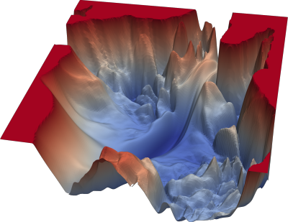
Non-convex Optimization
Global optima impossible!

Slide 4

Constrained Non-convex Optimization

Slide 5
Constrained Non-convex Optimization

Slide 6
Constrained Non-convex Optimization
?

Slide 7





Constrained Non-convex Optimization
CLS [Daskalakis Papadimitriou ‘11]
[Fearnley Goldberg Hollender ‘21]
[Hollender Jain Maystre Pires Robere Tao ‘22]
[Vavasis ‘92]
[Bubeck Mikulincer ‘20]

Slide 8

Constrained Non-convex Optimization
CLS [Daskalakis Papadimitriou ‘11]
[Fearnley Goldberg Hollender ‘21]
[Hollender Jain Maystre Pires Robere Tao ‘22]
[Hollender Zampetakis]

Slide 9



Unconstrained Non-convex Optimization

Slide 10

Unconstrained Non-convex Optimization
PLS [Johnson Papadimitriou Yannakakis 1988]
10
11
12
13
14
15
9
12
13
12
13
14
8
7
6
5
12
13
9
8
7
5
6
12
[Hollender Zampetakis]
10
9
8
6
7
11
11
10
9
7
8
10
12
13
10
8
9
11
[Hollender Zampetakis]

Slide 11
Open Problems
Higher dimensions?
  For unconstrained optimization is GD tight in 3D?
Second-order methods?
  Higher-order in general.
Non-smooth problems?
Stochastic methods?

Slide 12

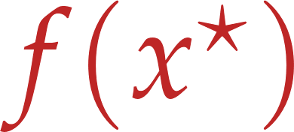

Intermediate Value Theorem

Slide 13
Intermediate Value Theorem

Slide 14
Intermediate Value Theorem (IVT)

Slide 15
Intermediate Value Theorem

Slide 16


Intermediate Value Theorem

Slide 17
Intermediate Value Theorem

Slide 18

Intermediate Value Theorem

Slide 19


Intermediate Value Theorem

Slide 20
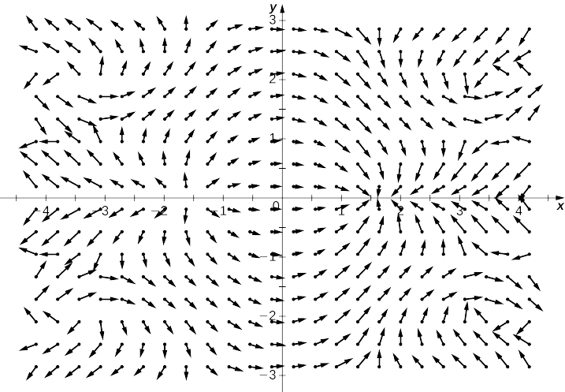

Intermediate Value Theorem in 2D?

Slide 21
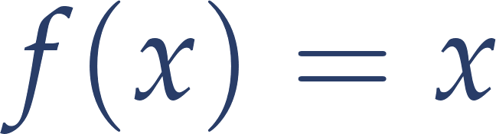

Intermediate Value Theorem in 2D
Brouwer’s Fixed Point Theorem

Slide 22
Sperner’s Lemma

Slide 23
Sperner’s Lemma

Slide 24
Sperner’s Lemma
Lemma: No matter how the internal nodes are colored there exists a tri-chromatic triangle. In fact, an odd number of them.

Slide 25
Sperner’s Lemma
Lemma: No matter how the internal nodes are colored there exists a tri-chromatic triangle. In fact, an odd number of them.

Slide 26
Sperner’s Lemma
!
Lemma: No matter how the internal nodes are colored there exists a tri-chromatic triangle. In fact, an odd number of them.

Slide 27
Sperner’s Lemma
Lemma: No matter how the internal nodes are colored there exists a tri-chromatic triangle. In fact, an odd number of them.

Slide 28
Sperner’s Lemma
Lemma: No matter how the internal nodes are colored there exists a tri-chromatic triangle. In fact, an odd number of them.

Slide 29
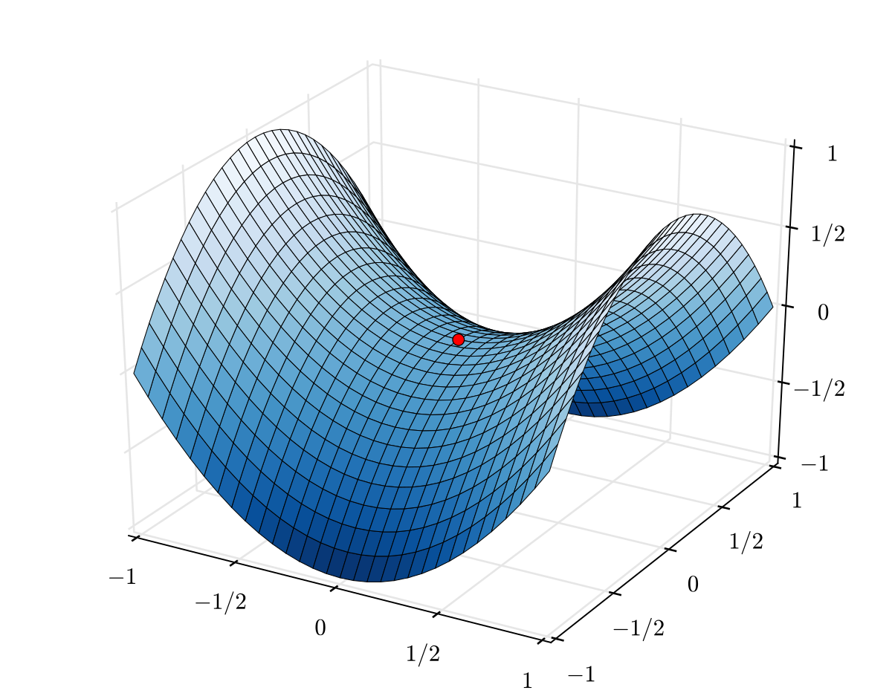
Intermediate Value Theorem in High-D
Brouwer’s Fixed Point Theorem
Sperner’s Lemma
[Papadimitriou 1994]
[Daskalakis Skoulakis Zampetakis ‘21]
PPAD

Slide 30
Intermediate Value Theorem
???

Slide 31
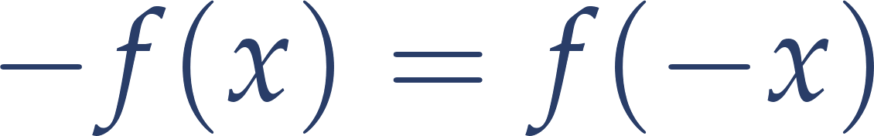
Intermediate Value Theorem in 2D v2
Borsuk Ulam Theorem

Slide 32
Intermediate Value Theorem in High-D v2
Borsuk Ulam Theorem
Tucker’s Lemma
[Aisenberg Bonet Buss ‘15]
[Goldberg Filos-Ratsikas ‘18]
PPA
Necklace Splitting
Ham Sandwich Theorem

Slide 33
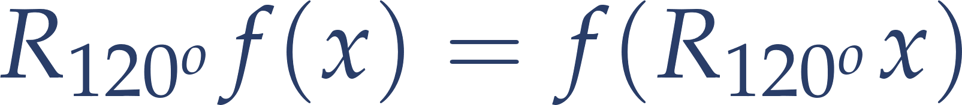
Intermediate Value Theorem in 2D v3

Slide 34
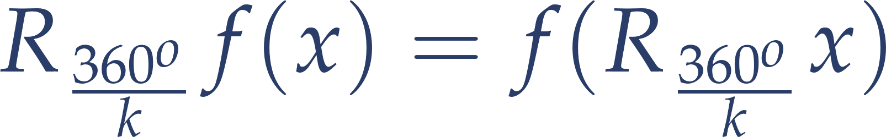
Intermediate Value Theorem in 2D vk

Slide 35


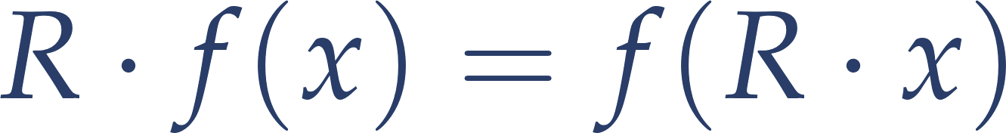

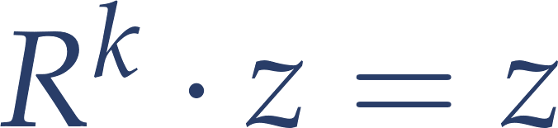
Intermediate Value Theorem in High-D vk
BSS Theorem

Slide 36
Intermediate Value Theorem in High-D vk
BSS Theorem
General Tucker’s Lemma
[Filos-Ratsikas Holleder Sotiraki Zampetakis ‘21]
PPA_{k}
Necklace Splitting

Slide 37


Intermediate Value Theorem in High-D vG
Dold’s Theorem

Slide 38
Open Problems
Necklace Splitting equivalence with BSS
Combinatorial proof of Dold’s Theorem?
Connections with cryptography?
Thank you! ☺

